Slide 2
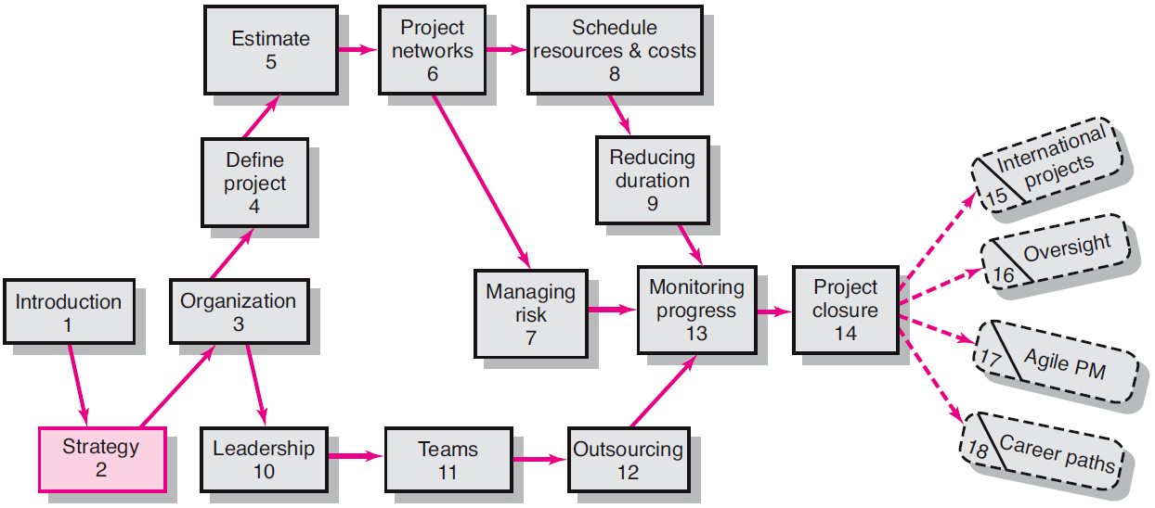
Where We Are Now

Slide 3
Chapter Objectives
To identify the significant role projects contribute to the strategic direction of the organization
To stress the importance of establishing project priorities and top management support
To describe the linkages of strategies and projects
To describe a scheme for prioritizing projects that ensures top management involvement and minimizes conflicts
To apply an objective priority system to project selection
To recognize that today’s world may require a shorter range strategic plan.

Slide 4
Strategy is implemented through projects.
Every project should have a clear link to the organization’s strategy.

Slide 5
Strategy is fundamentally deciding how the organization will compete.
Organizations use projects to convert strategy into new products, services, and processes needed for success.

Slide 6
Aligning projects with the strategic goals of the organization is crucial for project success.
Ensuring a strong link between the strategic plan and projects is a difficult task that demands constant attention from top and middle management.
The larger and more diverse an organization, the more difficult it is to create and maintain this strong link.

Slide 7
How can an organization ensure this link and alignment?
The answer requires integration of projects with the strategic plan.
A crucial factor to ensure the success of integrating the plan with projects lies in the creation of a process that is open and transparent for all participants to review.

Slide 8
Why Project Managers Need to Understand Strategy
Changes in the organization’s mission and strategy
Project managers must respond to changes with appropriate decisions about future projects and adjustments to current projects.
Project managers who understand their organization’s strategy can become effective advocates of projects aligned with the firm’s mission.

Slide 9
Projects and Strategy
Mistakes caused by not understanding the role of projects in accomplishing strategy:
Focusing on problems or solutions with low strategic priority.
Focusing on the immediate customer rather than the whole market place and value chain.
Overemphasizing technology that results in projects that pursue exotic technology that does not fit the strategy or customer need
Trying to solve customer issues with a product or service rather than focusing on the 20% with 80% of the value (Pareto’s Law).
Engaging in a never-ending search for perfection only the project team really cares about.

Slide 10
The Strategic Management Process: An Overview
Strategic Management
Requires every project to be clearly linked to strategy.
Provides theme and focus of firm’s future direction.
Responding to changes in the external environment—environmental scanning
Allocating scarce resources of the firm to improve its competitive position—internal responses to new programs
Requires strong links among mission, goals, objectives, strategy, and implementation.

Slide 11
Four Activities of the Strategic Management Process
Review and define the organizational mission.
Analyze and formulate strategies to reach objectives.
Set long-range goals and objectives.
Implement strategies through projects

Slide 12
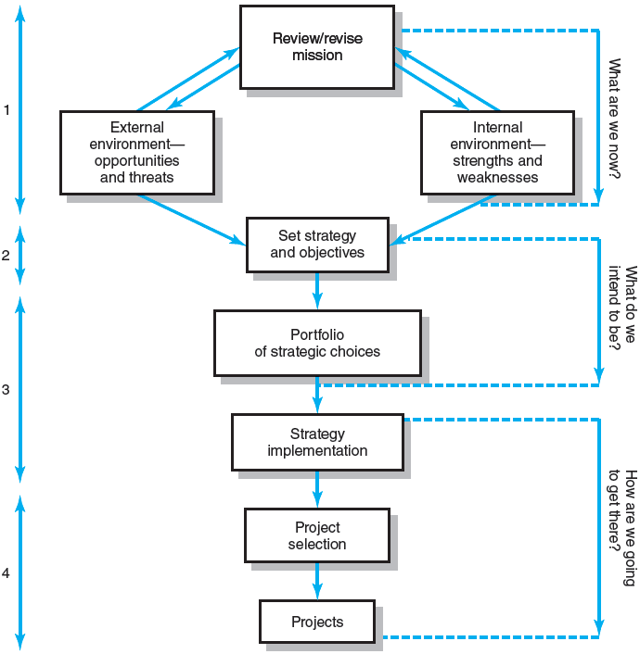
Strategic Management Process
FIGURE 2.1

Slide 13
More specific mission statements tend to give better results because of a tighter focus.
Mission statements decrease the chance of false directions by stakeholders.
Provide hospital design services.
Provide voice/data design services.
Provide information technology services.
Increase shareholder value.
Provide high-value products to our customer.
A rule-of-thumb test for a mission statement is, if the statement can be anybody’s mission statement, it will not provide the guidance and focus intended.

Slide 14
Characteristics of Objectives
S Specific Be specific in targeting an objective M Measurable Establish a measurable indicator(s) of progress A Assignable Make the objective assignable to one person for completion
R Realistic State what can realistically be done with available resources
T Time related State when the objective can be achieved, that is, duration
EXHIBIT 2.1

Slide 15
Project Portfolio Management: The Need for a Strong Project Priority System
The Implementation Gap
The lack of understanding and consensus on strategy among top management and middle-level (functional) managers who independently implement the strategy.
Organization Politics
Project selection is based on the persuasiveness and power of people advocating the projects.
Resource Conflicts and Multitasking
Multiproject environment creates interdependency relationships of shared resources which results in the starting, stopping, and restarting projects.

Slide 16
Benefits of Project Portfolio Management
Builds discipline into the project selection process.
Links project selection to strategic metrics.
Prioritizes project proposals across a common set of criteria, rather than on politics or emotion.
Allocates resources to projects that align with strategic direction.
Balances risk across all projects.
Justifies killing projects that do not support strategy.
Improves communication and supports agreement on project goals.
EXHIBIT 2.2

Slide 17
A Portfolio Management System
Design of a project portfolio system:
Classification of a project
Selection criteria depending upon classification
Sources of proposals
Evaluating proposals
Managing the portfolio of projects.

Slide 18
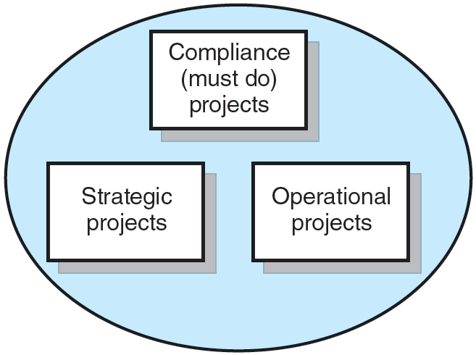
Portfolio of Projects by Type
FIGURE 2.2

Slide 19
A Portfolio Management System
Selection Criteria
Financial models: payback, net present value (NPV)
Non-financial models: projects of strategic importance to the firm.
Multi-Weighted Scoring Models
Use several weighted selection criteria to evaluate project proposals.

Slide 20
Financial Models
The Payback Model
Measures the time the project will take to recover the project investment.
Uses more desirable shorter paybacks.
Emphasizes cash flows, a key factor in business.
Limitations of Payback:
Ignores the time value of money.
Assumes cash inflows for the investment period (and not beyond).
Does not consider profitability.

Slide 21
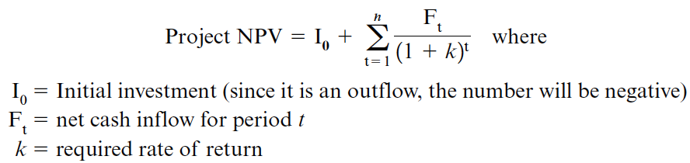
Financial Models (cont’d)
The Net Present Value (NPV) model
Uses management’s minimum desired rate-of-return (discount rate) to compute the present value of all net cash inflows.
Positive NPV: project meets minimum desired rate of return and is eligible for further consideration.
Negative NPV: project is rejected.

Slide 22
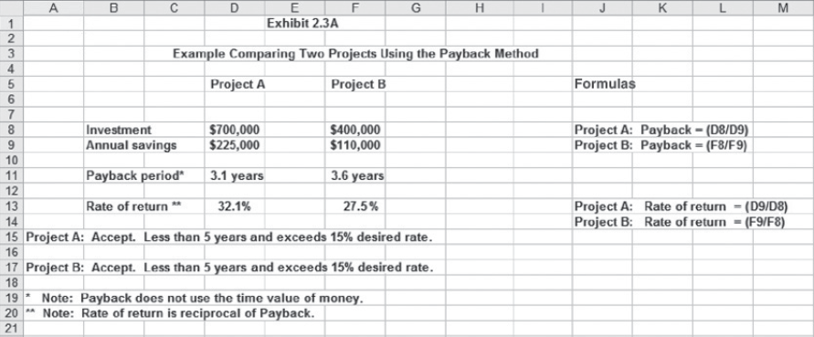
Example Comparing Two Projects Using Payback Method
EXHIBIT 2.3a

Slide 23
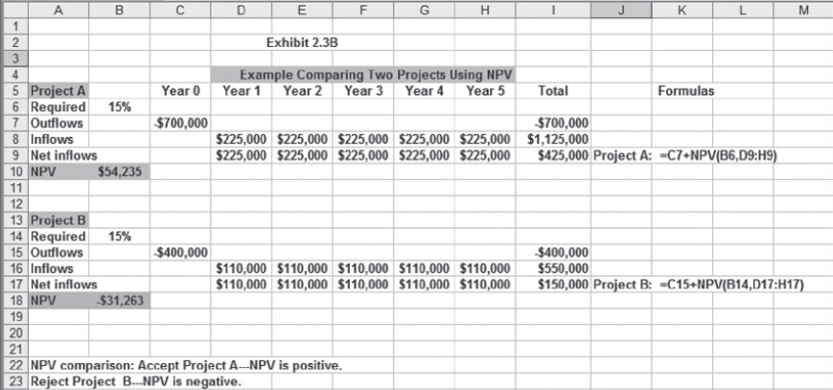
Example Comparing Two Projects Using Net Present Value Method
EXHIBIT 2.3b

Slide 24
Nonfinancial Strategic Criteria
To capture larger market share
To make it difficult for competitors to enter the market
To develop an enabler product, which by its introduction will increase sales in more profitable products
To develop core technology that will be used in next-generation products
To reduce dependency on unreliable suppliers
To prevent government intervention and regulation
To restore corporate image or enhance brand recognition
To demonstrate its commitment to corporate citizenship and support for community development.

Slide 25
Multi-Criteria Selection Models
Checklist Model
Uses a list of questions to review potential projects and to determine their acceptance or rejection.
Fails to answer the relative importance or value of a potential project and doesn’t to allow for comparison with other potential projects.
Multi-Weighted Scoring Model
Uses several weighted qualitative and/or quantitative selection criteria to evaluate project proposals.
Allows for comparison of projects with other potential projects

Slide 26
Sample Selection Questions Used in Practice
Topic | Question
Strategy/alignment | What specific strategy does this project align with?
Driver | What business problem does the project solve?
Success metrics | How will we measure success?
Sponsorship | Who is the project sponsor?
Risk | What is the impact of not doing this project?
Risk | What is the project risk to our organization?
Risk | Where does the proposed project fit in our risk profile?
Benefits, value, ROI | What is the value of the project to this organization?
Benefits, value, ROI | When will the project show results?
Objectives | What are the project objectives?
EXHIBIT 2.4

Slide 27
Sample Selection Questions Used in Practice
Topic | Question
Organization culture | Is our organization culture right for this type of project?
Resources | Will internal resources be available for this project?
Approach | Will we build or buy?
Schedule | How long will this project take?
Schedule | Is the time line realistic?
Training/resources | Will staff training be required?
Finance/portfolio | What is the estimated cost of the project?
Portfolio | Is this a new initiative or part of an existing initiative?
Portfolio | How does this project interact with current projects?
Technology | Is the technology available or new?
EXHIBIT 2.4 cont’d

Slide 28
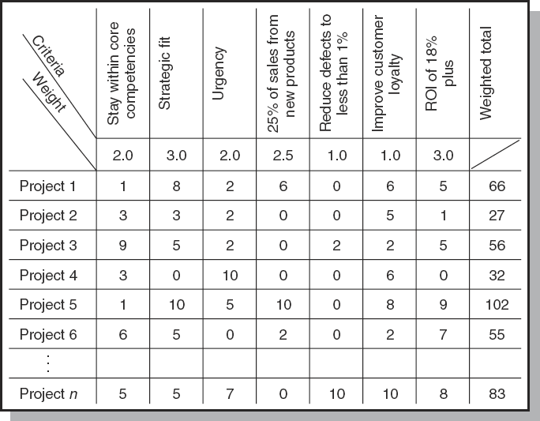
Project Screening Matrix
FIGURE 2.3

Slide 29
Applying a Selection Model
Project Classification
Deciding how well a strategic or operations project fits the organization’s strategy.
Selecting a Model
Applying a weighted scoring model to align projects closer with the organization’s strategic goals.
Reduces the number of wasteful projects
Helps identify proper goals for projects
Helps everyone involved understand how and why a project is selected

Slide 30
Project Proposals
Sources and Solicitation of Project Proposals
Within the organization
Request for proposal (RFP) from external sources (contractors and vendors)
Ranking Proposals and Selection of Projects
Prioritizing requires discipline, accountability, responsibility, constraints, reduced flexibility, and loss of power.
Managing the Portfolio
Senior management input
The priority team (project office) responsibilities

Slide 31
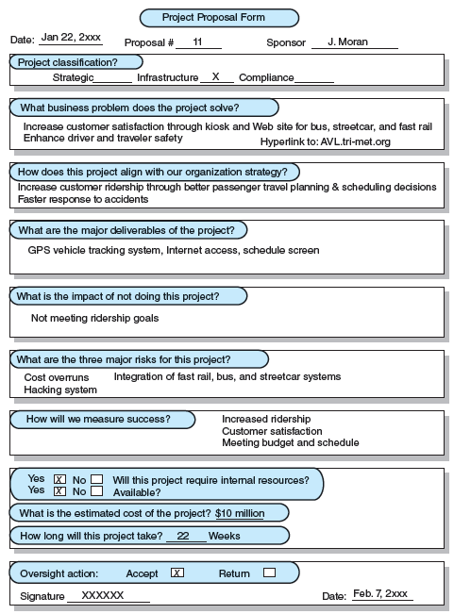
A Proposal Form for an Automatic Vehicular Tracking (AVL) Public Transportation Project
FIGURE 2.4A

Slide 32
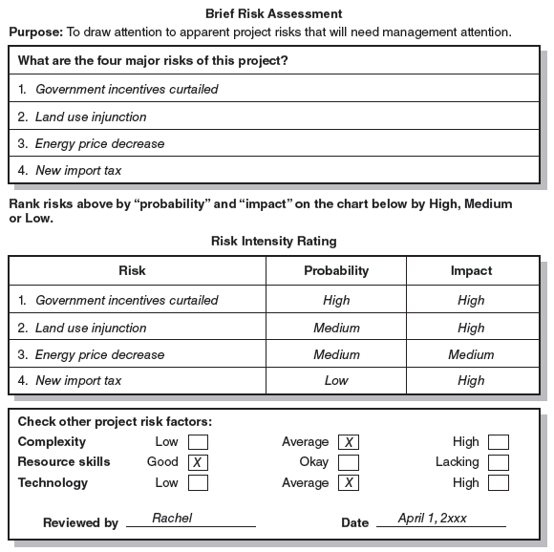
Risk Analysis for 500-Acre Wind Farm
FIGURE 2.4B

Slide 33
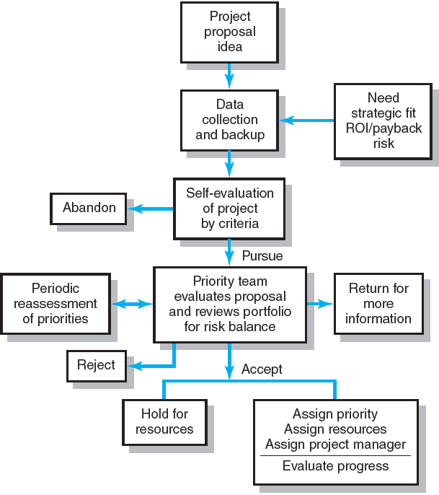
Project Screening Process
FIGURE 2.5

Slide 34
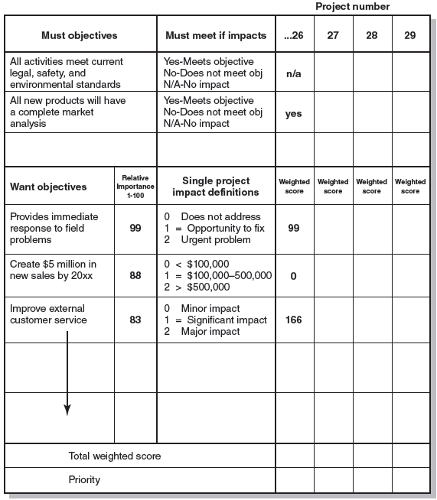
Priority Analysis
FIGURE 2.6

Slide 35
Managing the Portfolio System
Senior Management Input
Provide guidance in selecting criteria that are aligned with the organization’s strategic goals
Decide how to balance available resources among current projects
The Governance Team Responsibilities
Publish the priority of every project
Ensure that the project selection process is open and free of power politics.
Reassess the organization’s goals and priorities
Evaluate the progress of current projects

Slide 36
Balancing the Portfolio for Risks and Types of Projects
Bread-and-butter Projects
Involve evolutionary improvements to current products and services.
Pearls
Represent revolutionary commercial opportunities using proven technical advances.
Oysters
Involve technological breakthroughs with high commercial payoffs.
White Elephants
Showed promise at one time but are no longer viable.

Slide 37
Key Terms
Implementation gap
Net present value
Organizational politics
Payback
Priority system
Priority team
Project portfolio Project screening matrix
Project sponsor
Sacred cow
Strategic management process

